Slide 1



A Summary of 1076 - 2019 IEEE Standard VHDL Language Reference Manual
by Furkan Kaya, Koray Karakurt,
Mert Ecevit, Orhan Çalışkan, Seyit Koçak and Yunus Küçük
27/12/2024

Slide 2
3. Design entities & configurations
Chapter 3
Presenter:
Furkan Kaya
3.1 General
3.2 Entity Declarations
3.3 Architecture Bodies
3.4 Configuration Declarations

Slide 3
3.1 GENERAL
Design
3.2 ENTITY DECLARATIONS
Architecture

Slide 4
CODE EXAMPLE
library IEEE;
use IEEE.std_logic_1164.all;
use IEEE.numeric_std.all;
entity generic_adder is
generic
(
data_width : integer := 32
);
port
(
input_a : in std_logic_vector (data_width-1 downto 0);
input_b : in std_logic_vector (data_width-1 downto 0);
output_adder : out std_logic_vector (data_width downto 0)
);
end generic_adder;
architecture behavioral of generic_adder is
signal output_internal : signed (output_adder'range);
begin
output_internal <= signed(input_a) + signed(input_b);
output_adder <= std_logic_vector(output_internal);
end architecture behavioral;

Slide 5
4. Subprograms & packages
Chapter 4
Presenter:
Seyit Koçak
4.1 General
4.2 Subprogram Declarations
4.3 Subprogram Bodies
4.4 Subprogram Instantiation Declarations
4.5 Subprogram Overloading
4.6 Resolution Functions
4.7 Package Declarations
4.8 Package Bodies
4.9 Package Instantiation Declarations
4.10 Conformance Rules

Slide 6
4.1 GENERAL
Subprograms define algorithms through procedures and functions, serving to compute values or perform actions
Procedures are subprograms that execute a series of statements to perform actions but do not return a value. They are called as statements and can modify the state of the program
Functions are classified as pure or impure
Packages separate the declarations and bodies of these subprograms, allowing common resources to be shared
4.2 SUBPROGRAM DECLERATİONS
Subprogram declarations define procedures or functions by specifying their designator, parameters, generics (if any), and for functions, the return type and whether it is pure or impure
Procedures are always identified by a name, while functions can also be identified by operator symbols, enabling operator overloading
Functions return a value, whereas procedures execute actions without returning any value and can modify external variables or signals
-

Slide 7
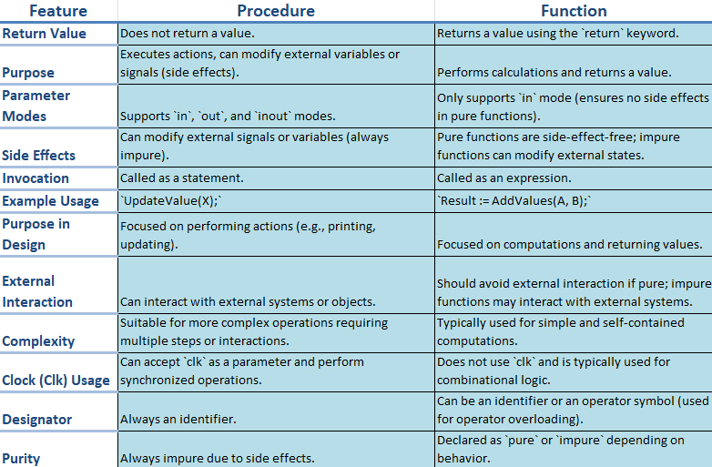
CODE EXAMPLE
library IEEE;
use IEEE.std_logic_1164.all;
use IEEE.numeric_std.all;
entity procedurewithclock is
port (
clk : in std_logic;
reset : in std_logic;
data_in : in std_logic_vector(7 downto 0);
data_out : out std_logic_vector(7 downto 0)
);
end procedurewithclock;
architecture behavioral of procedurewithclock is
procedure updatevalue(
signal clk : in std_logic;
signal reset : in std_logic;
signal data_in : in std_logic_vector(7 downto 0);
variable data_out : inout std_logic_vector(7 downto 0)
) is
begin
if reset = '1' then
data_out := (others => '0');
elsif rising_edge(clk) then
data_out := data_in;
end if;
end procedure;
begin
process(clk, reset)
variable temp_data : std_logic_vector(7 downto 0);
begin
updatevalue(clk, reset, data_in, temp_data);
data_out <= temp_data;
end process;
end behavioral;

Slide 8
4.2 SUBPROGRAM DECLARATİONS
Pure functions always return the same output for the same input values
Impure functions may produce different outputs for the same inputs or modify external variables or signals
Constant parameters allow read-only access, while variable parameters allow both reading and writing of values during subprogram execution.
Signal parameters pass references to signals, their drivers, or both into the subprogram call Assignments to signal parameters directly affect the actual signal drivers associated with them
4.3 SUBPROGRAM BODIES
A body consists of three main parts: specification (definition of parameters and type), declarative part (variables, constants, or nested subprograms), and statement part (sequential operations)
4.4 SUBPROGRAM INSTANTIATION DECLARATIONS
Subprogram instantiation customizes a general subprogram template into an independent version with specific parameters or generics

Slide 9
CODE EXAMPLE
library IEEE;
use IEEE.std_logic_1164.all;
use IEEE.numeric_std.all;
package my_subprograms is
function add_integer(a, b: integer) return integer;
end my_subprograms;
package body my_subprograms is
function add_integer(a, b: integer) return integer is
begin
return a + b;
end add_integer;
end my_subprograms;
use work.my_subprograms.all;
entity subprograminstantiationexample is
port (
a, b : in integer;
c, d : in integer;
result_int : out integer;
result_real: out integer
);
end subprograminstantiationexample;
architecture behavioral of subprograminstantiationexample is
constant threshold : integer := 10;
begin
process(a, b, c, d)
variable tempresultint : integer; --temporary storage
variable tempresultreal : integer;
begin
if (a > threshold and b > threshold) then
tempresultint := add_integer(a, b);
result_int <= tempresultint;
else
result_int <= 0;
end if;
if (c > threshold and d > threshold) then
tempresultreal := add_integer(c, d);
result_real <= tempresultreal;
else
result_real <= 0;
end if;
end process;
end behavioral;

Slide 10
4.7,8,9 PACKAGE DECLARATIONS,BODIES,INSTANTIATION
Package declarations define the interface of a package, including constants, types, subprograms, and generics
Items declared in a package can be made visible in other design units through selection or use clauses
A package body must match its corresponding package declaration and follow it in the same declarative region
Package instantiation declarations create an instance of an uninstantiated package, associating actuals with generics through a generic map aspect
The instance behaves like a generic-mapped package with declarations and bodies from the uninstantiated package
CODE EXAMPLE
library IEEE;
use IEEE.std_logic_1164.all;
package mypackage is
constant default_value: integer := 10;
function double(value: integer) return integer;
function triple(value: integer) return integer;
end package mypackage;
package body mypackage is
function double(value: integer) return integer is
begin
return value * 2;
end function double;
function triple(value: integer) return integer is
begin
return value * 3;
end function triple;
end package body mypackage;
entity packageexample is
port (
inputvalue : in integer;
outputvalue : out integer;
triplevalue : out integer
);
end packageexample;
architecture behavioral of packageexample is
use work.mypackage.all;
begin
process(inputvalue)
begin
outputvalue <= double(inputvalue);
triplevalue <= triple(inputvalue);
end process;
end behavioral;

Slide 11
5. tYPES
Chapter 5
Presenter:
Seyit Koçak
5.1 General
5.2 Scalar Types
5.3 Composite Types
5.4 Access Types
5.5 File Types
5.6 Protected Types
5.7 String Representations
5.8 Unspecified Types

Slide 12
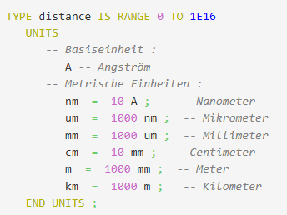
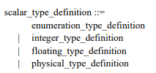
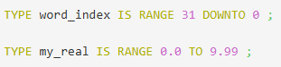
5.1 GENERAL
A type is defined by a set of values and operations, including basic and predefined operations automatically provided
Composite types can be unconstrained, fully constrained, or partially constrained
Types are divided into five main categories: scalar, composite, access, file, and protected types
5.2 SCALAR TYPES

Slide 13
CODE EXAMPLE
library IEEE;
use IEEE.std_logic_1164.all;
use IEEE.numeric_std.all;
entity vhdl_fsm is
port(
clk: in std_logic;
reset: in std_logic;
in1: in unsigned(4 downto 0);
in2: in unsigned(4 downto 0);
out_1: out unsigned(4 downto 0)
);
end vhdl_fsm;
architecture rtl of vhdl_fsm is
type tstate is (state_0, state_1, state_2, state_3, state_4);
signal state: tstate;
signal next_state: tstate;
begin
process(clk, reset)
begin
if reset = '1' then
state <= state_0;
elsif rising_edge(clk) then
state <= next_state;
end if;
end process;
process(state, in1, in2)
variable tmp_out_0: unsigned(4 downto 0);
variable tmp_out_1: unsigned(4 downto 0);
begin
tmp_out_0 := in1 + in2;
tmp_out_1 := in1 - in2;
case state is
when state_0 =>
out_1 <= in1;
next_state <= state_1;
when state_1 =>
if (in1 < in2) then
next_state <= state_2;
out_1 <= tmp_out_0;
else
next_state <= state_3;
out_1 <= tmp_out_1;
end if;
when state_2 =>
if (in1 < "0100") then
out_1 <= tmp_out_0;
else
out_1 <= tmp_out_1;
end if;
next_state <= state_3;
when state_3 =>
out_1 <= "11111";
next_state <= state_4;
when state_4 =>
out_1 <= in2;
next_state <= state_0;
when others =>
out_1 <= "00000";
next_state <= state_0;
end case;
end process;
end rtl;

Slide 14
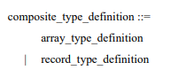
5.3 COMPOSITE TYPES
VHDL arrays store multiple elements of the same type in an organized way and provide fast access
Arrays are used for grouping data, modeling multidimensional structures, and performing operations on large data sets
They serve as a foundation for creating dynamic data structures and algorithms, enabling efficient data management and simulation
Record types in VHDL allow grouping of different types of elements under a single name, where each element can have a different data type
Record types are useful for modeling complex data structures where multiple related values need to be stored together, such as a set of properties for an object

Slide 15
CODE EXAMPLE
library IEEE;
use IEEE.std_logic_1164.all;
use IEEE.numeric_std.all;
entity generic_adder is
generic
(
data_width : integer := 32
);
port
(
input_a : in std_logic_vector (data_width-1 downto 0);
input_b : in std_logic_vector (data_width-1 downto 0);
output_adder : out std_logic_vector (data_width downto 0)
);
end generic_adder;
architecture behavioral of generic_adder is
signal output_internal : signed (output_adder'range);
begin
output_internal <= signed(input_a) + signed(input_b);
output_adder <= std_logic_vector(output_internal);
end architecture behavioral;

Slide 16
End of IEEE 1076 – 2002 Standard
VHDL Project Closure Presentation
THANKS
Furkan Kaya,
Mert Ecevit,
Orhan Çalışkan,
Seyit Koçak
Yunus Küçük
www.youtube.com/@falsepaths

